Slide 1

Project name: Next-Day Stock Price Forecast
Subject: Deep Learning
Project Link: https://github.com/paolosilv/deep-learning2023
Student: Paolo Silvestri
Student ID: 521343

Slide 2
Project Goals
Next day stock closing price (short-term prediction)
Should I buy or sell for tomorrow?

Slide 3
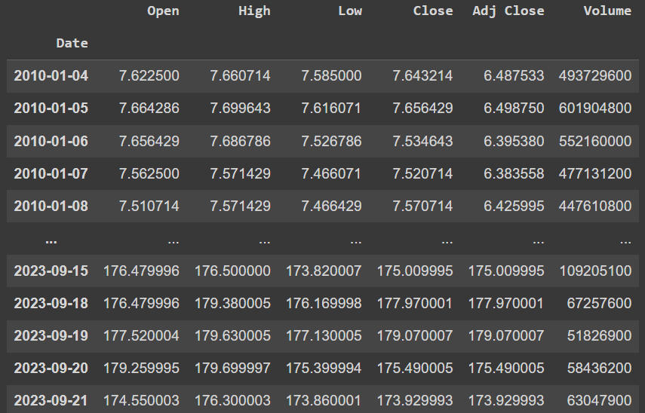
Data
Stock Symbol: AAPL -> APPLE
Provider: Yahoo Finance
Data Period: 2010-01-01 -> 2023-09-21
Primary Data Structure:

Slide 4
Data Pre-Processing
Features: «Close», «Volume», «RSI»
Data scaling -> MinMaxScaler
Training sequence -> 5 days

Slide 5
Data Splitting
Train size -> 85% -> 2930 rows
Test size -> 15% -> 518 rows
Batch size -> 64

Slide 6
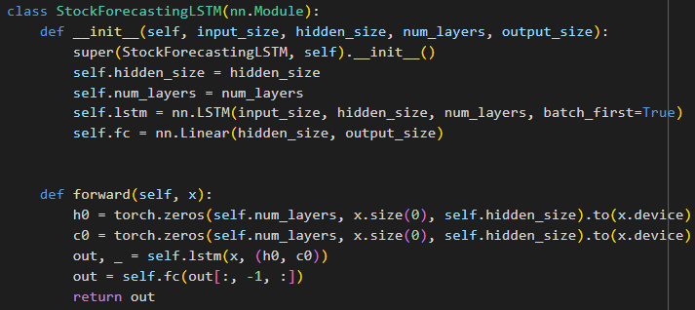
Model Structure
LSTM -> 2 Layers | 64 Hidden Size
Fully Connected -> 1 Output

Slide 7
Loss and Optimizer
Loss Metric -> MSE (Mean Squared Error)
= (1/n) * Σ(yᵢ - ŷᵢ)²
Optimizer -> ADAM (Adaptive Moment Estimation)

Slide 8
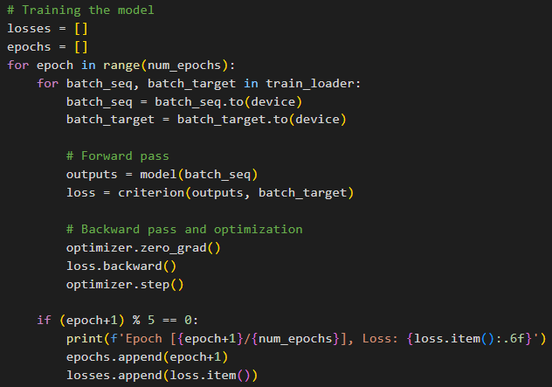
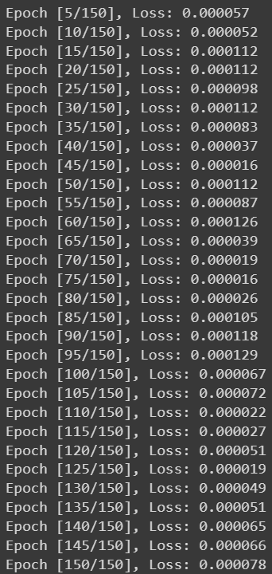
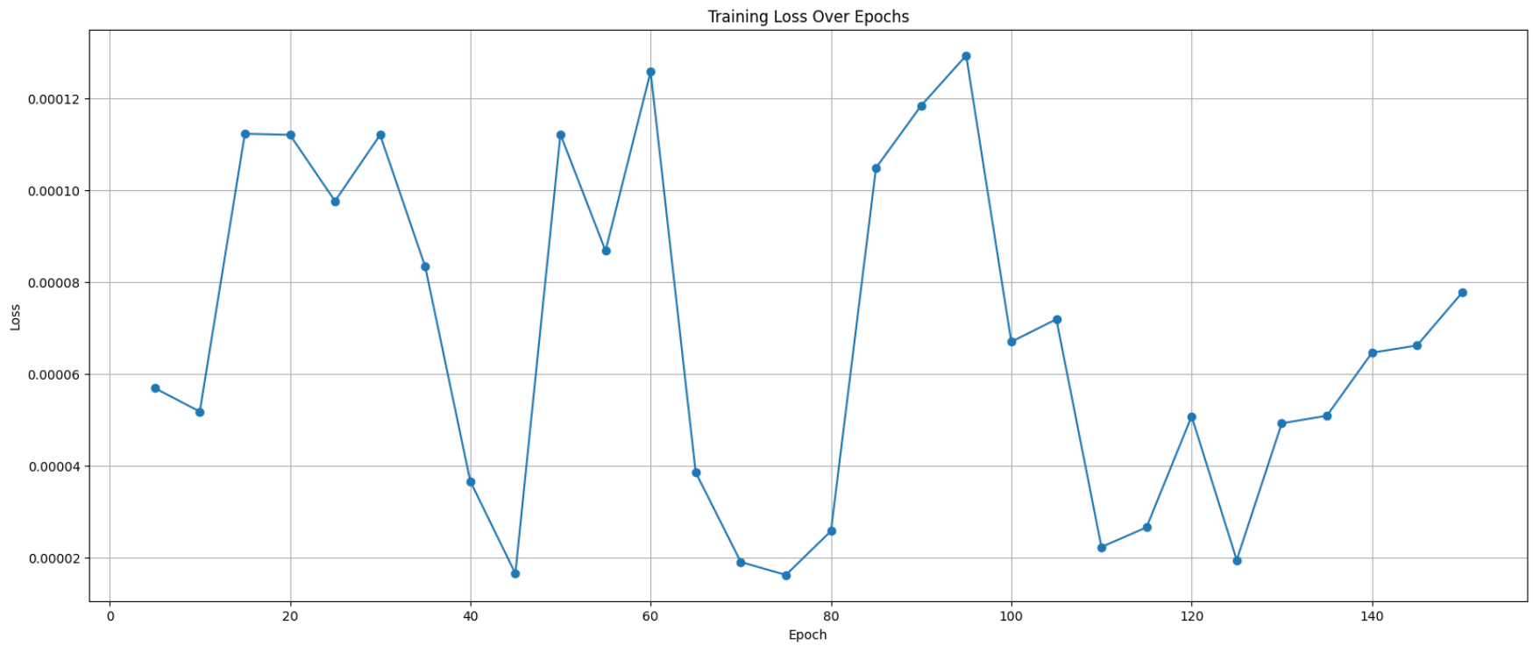
Training
Epochs -> 150
Learning Rate -> 0.001

Slide 9
Different approaches, average results
Epochs: 150, seq_length : 5 days, lr = 0.001, LSTM layers = 2, LSTM hidden size = 64
1) Features: «Close» | MSE: 12.244 | Accuracy: 51.14%
2) Features: «Close», «Volume», «RSI» | MSE: 11.764 | Accuracy: 54.66% -> the best one
3) Features: «Close», «Volume», «RSI», «MACD» | MSE: 18.338 | Accuracy: 52.53%
4) Features: «Close», «Volume», «RSI», «MACD», «ATR» | MSE: 20.048 | Accuracy: 51.32%
5) Features: «Close», «Volume», «RSI», «MACD», «ATR», «50-MA» | MSE: 13.261 | Accuracy: 52.54%

Slide 10
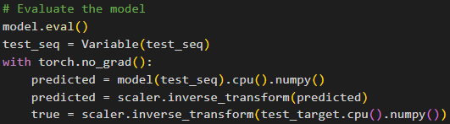

Testing
MSE -> 10.7306
Buy or Sell Accuracy -> 55.32%

Slide 11
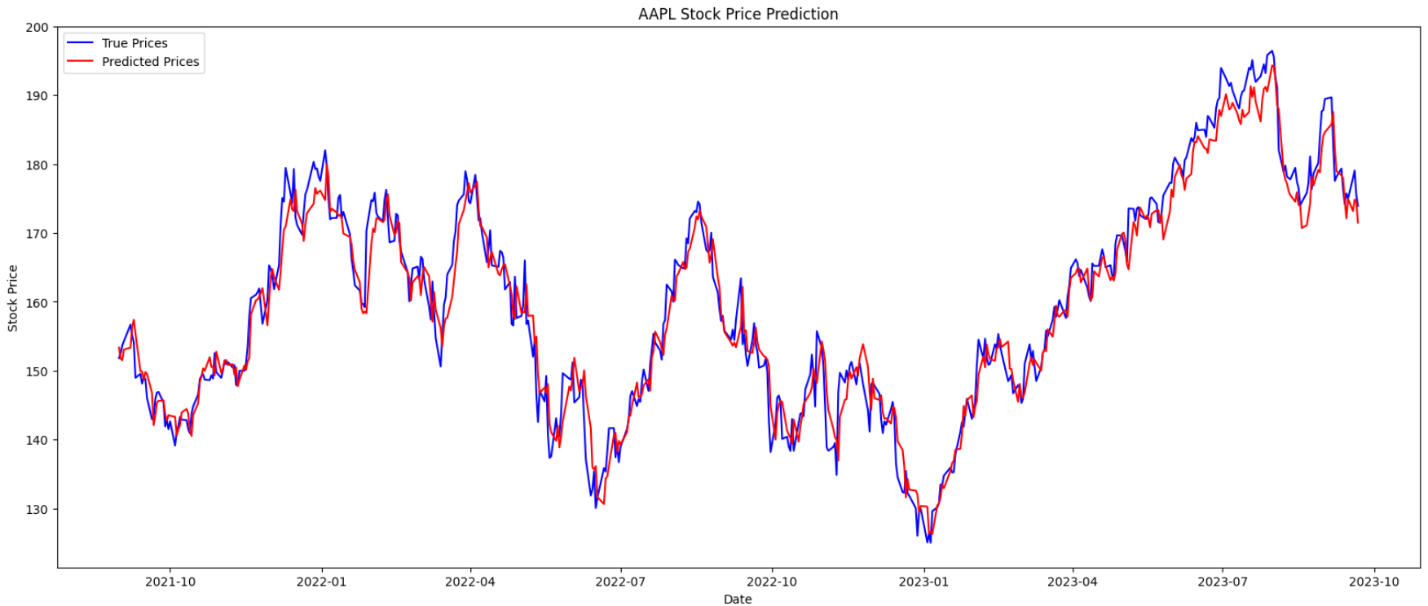
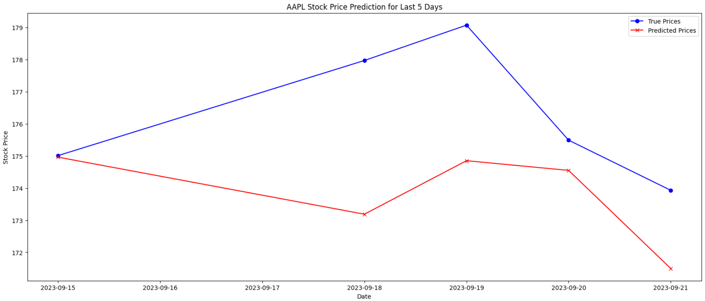

Slide 12
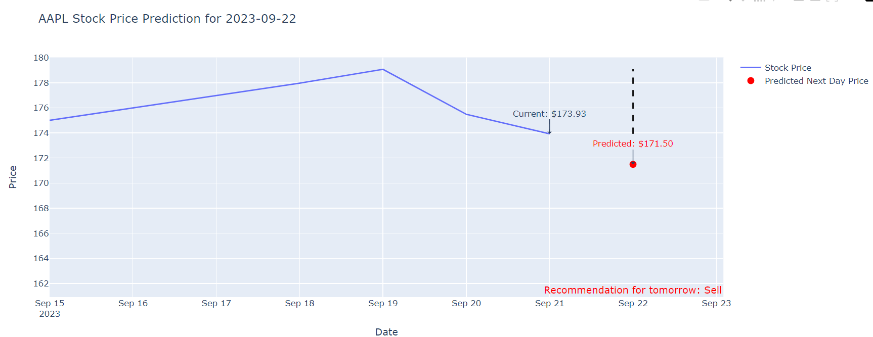
Next Day Prediction -> 2023-09-22
Buy or Sell for tomorrow?

Slide 13
Thank You

